Slide 1
Stock trading optimization using DQN
Agnibh Dasgupta

Slide 2
Method- DQN
State space – [Image of the stock, holdings, volume]
Action space – [Buy, Hold, Sell]
Initially takes random actions to learn
Eventually takes greedy
Reward = Difference in (price*holdings)
Uses a CNN+FC to approximate Q values based on images of the stock

Slide 3
Image of the stock
The idea is to emulate the human perspective when making decisions on stock
Use the image of the stock market (for a number data entries)

Slide 4
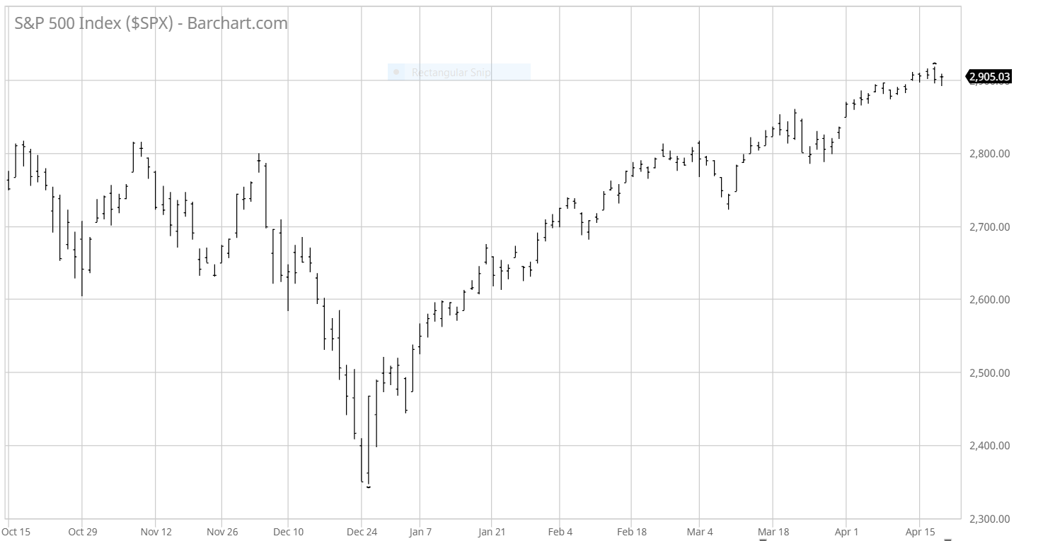
Candlesticks

Slide 5
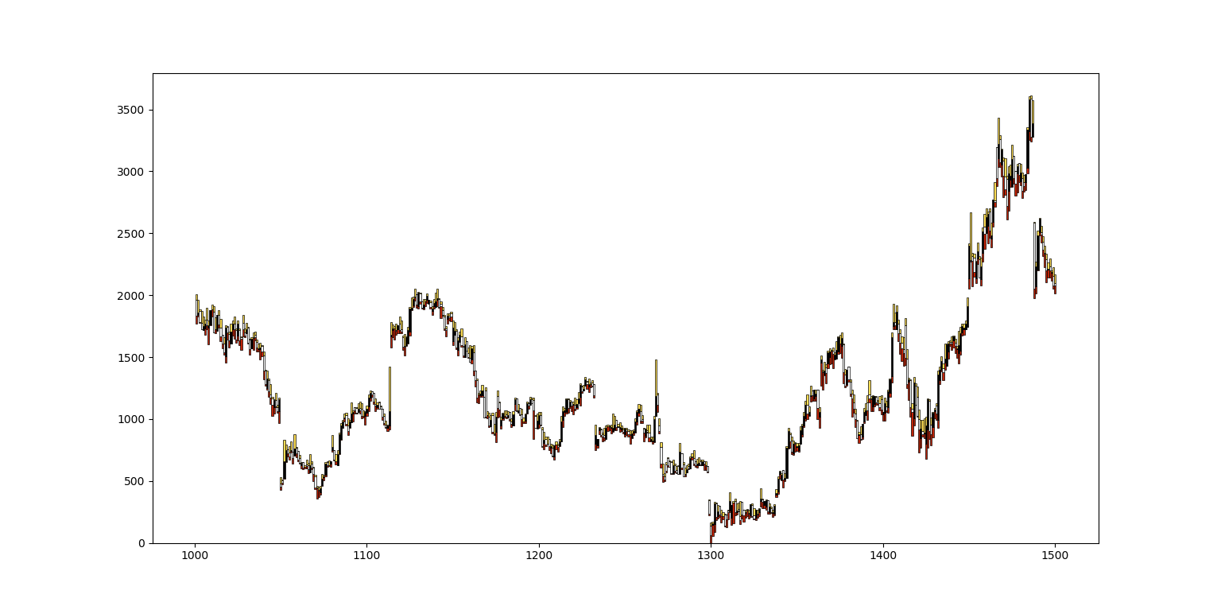
Stacked Bar graphs

Slide 6
Image of the stock
Open | High | Low | Close
4.437143 | 4.492857 | 4.374286 | 4.442857
4.464286 | 4.525714 | 4.371428 | 4.428571
4.414286 | 4.431428 | 4.351429 | 4.42
4.385714 | 4.455714 | 4.285714 | 4.308571
4.33 | 4.398571 | 4.247143 | 4.307143

Slide 7
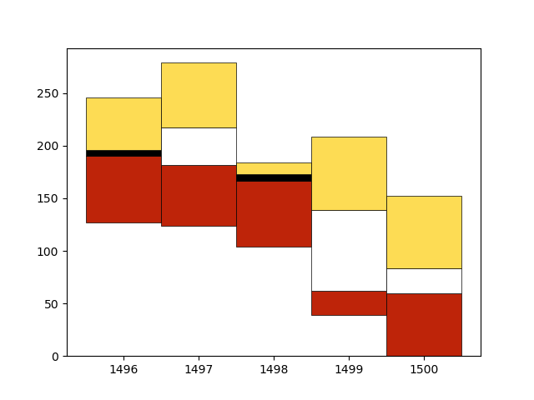
Image of the stock

Slide 8

Image of the stock

Slide 9
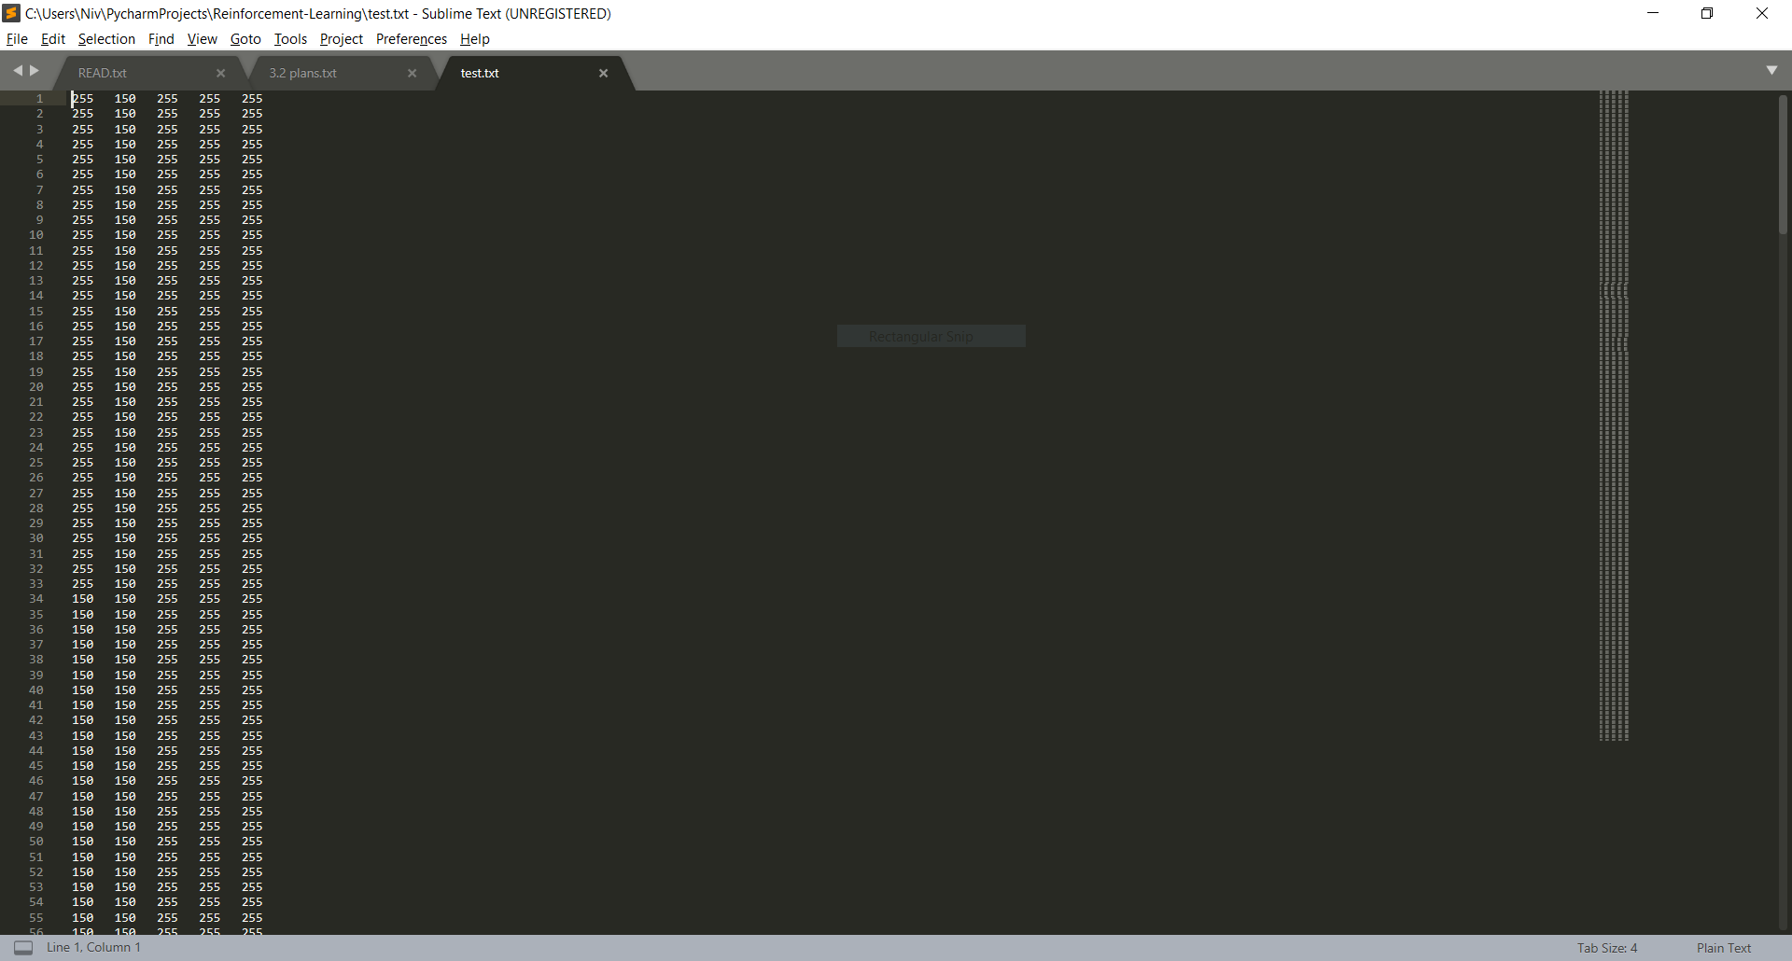
Image of the stock

Slide 10
Image size
Number of column pixels / X = window size (number of days in my current dataset)
Number of rows pixels / Y = Difference in the max and min price in the window size (Price includes open, close, high, low)

Slide 11
Problems
Image size(y/number of rows) varies according to the price changes in the window – Varying image sizes
The CNN followed by FC and needs static image size
Solution (for now): Padding every image to the max dimension it can be
Issue – Large image sizes (Upto 30000x40), takes forever to train/runs out of memory
Solution (for now) – Shrink the image (1000 x 40). Has less precision, but runs faster

Slide 12
Before shrinking

Slide 13
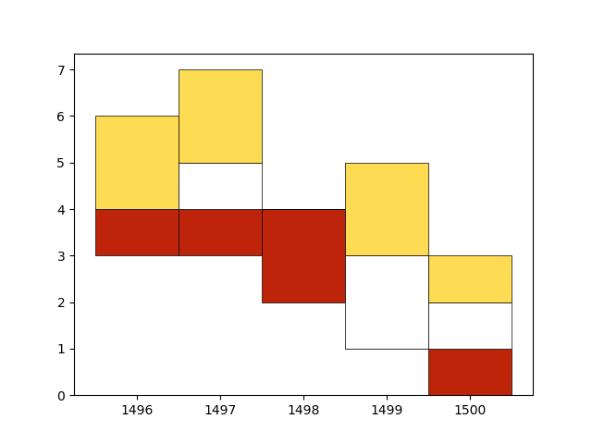
After shrinking

Slide 14

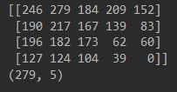
Before shrinking

Slide 15
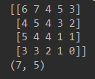
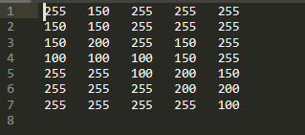
After shrinking

Slide 16
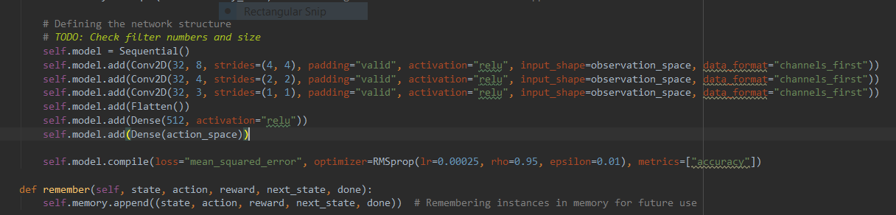
Network:

Slide 17
Experience Replay and Batch Sampling
‘Remembers’ experiences while trading in the form of:
[state, action, reward, next_state]
Has an upper limit, forgets older memories as it gets new ones.
Randomly samples a batch within the memory.
Computes Q values and fits model.

Slide 18
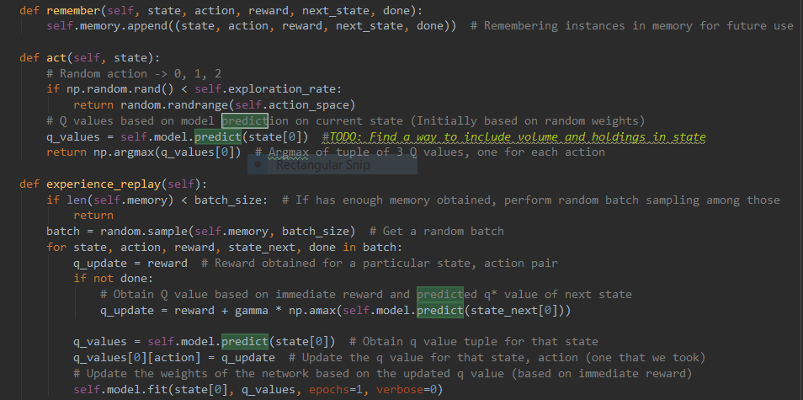
Experience Replay and Batch Sampling

Slide 19
Parameters:
gamma = 0.95
learning_rate = 0.001
memory_size = 1000
batch_size = 32
window_size = 5
precision = 2
static_image_size = (1000, 40)

Slide 20
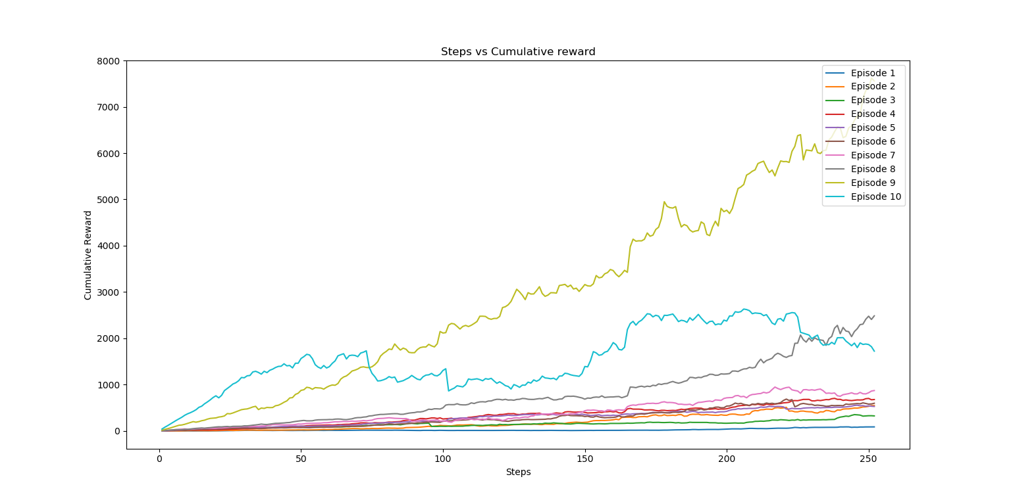
Results so far:10 Episodes. 252 Steps.

Slide 21
Stuff to do
Find better ways to handle large image sizes without losing much accuracy?
Include volume and position in the state
Tune network parameters
Run on test set

Slide 22
Thanks!

